Slide 1
DGS Coding guideline Compiler Independency

Slide 2
Table of Contents
Overview
C99 Compliance
Controller data width
Single Bit Handling
Assembler programming
Intrinsic functions
2
RBEI/EEP1 | 9/23/2016
© Robert Bosch Engineering and Business Solutions Vietnam Company Limited 2016. All rights reserved, also regarding any disposal, exploitation, reproduction, editing, distribution, as well as in the event of applications for industrial property rights.

Slide 3
Overview
In the future, DGS source code will be:
Used on several μC platforms and compiled via several compilers
Integrated in UBK and foreign ECUs
3
RBEI/EEP1 | 9/23/2016
© Robert Bosch Engineering and Business Solutions Vietnam Company Limited 2016. All rights reserved, also regarding any disposal, exploitation, reproduction, editing, distribution, as well as in the event of applications for industrial property rights.

Slide 4
C99 Compliance
Conform to ISO/IEC 9899:1999 (ISO C99) “Programming languages − C”
Some deviations and extensions are permitted for automotive applications
4
RBEI/EEP1 | 9/23/2016
© Robert Bosch Engineering and Business Solutions Vietnam Company Limited 2016. All rights reserved, also regarding any disposal, exploitation, reproduction, editing, distribution, as well as in the event of applications for industrial property rights.

Slide 5
C99 Compliance
In accordance to the recommendations given by the MISRA−C: 2004 and MISRA−C:2012
Width of C−data types
char is 8 bit
short is 16 bit
int is 16 bit or 32 bit
long is 32 bit
If available long long is 64 bit ( for 32-bit machines)
See Chapter 5.3 "Data types" p. 28
5
RBEI/EEP1 | 9/23/2016
© Robert Bosch Engineering and Business Solutions Vietnam Company Limited 2016. All rights reserved, also regarding any disposal, exploitation, reproduction, editing, distribution, as well as in the event of applications for industrial property rights.

Slide 6
C99 Compliance
In accordance to the recommendations given by the MISRA−C: 2004 and MISRA−C:2012
C−language implementation
Unsigned char (resp. uint8 ) is the smallest addressable memory unit
Unsigned char (resp. uint8 ) has the smallest alignment
Negative numbers are represented by the two's complement
Arithmetic shift on signed operands
For integers, "/" operator is the algebraic quotient with any fractional part discarded
=> the expression (a/b)*b + a%b shall equal a
6
RBEI/EEP1 | 9/23/2016
© Robert Bosch Engineering and Business Solutions Vietnam Company Limited 2016. All rights reserved, also regarding any disposal, exploitation, reproduction, editing, distribution, as well as in the event of applications for industrial property rights.

Slide 7
C99 Compliance
In accordance to the recommendations given by the MISRA−C: 2004 and MISRA−C:2012
C99 limits
Nesting of parentheses | 63
Nesting of struct or union types | 63
Number of block scope identifiers in a block | 511
Number of members in struct or union | 1023
Number of enumeration constants | 1023
Nesting of control structures (statements) | 127
Number of case labels | f1023
Nesting levels of #include "%s" | f15
Nesting level of #if... | f63
Characters for Identifier | 120
Number of macro definitions simultaneously defined | 4095
AUTOSAR ememory meapping concepts or DGS tool chain related | …
7
RBEI/EEP1 | 9/23/2016
© Robert Bosch Engineering and Business Solutions Vietnam Company Limited 2016. All rights reserved, also regarding any disposal, exploitation, reproduction, editing, distribution, as well as in the event of applications for industrial property rights.

Slide 8
C99 Compliance
In accordance to the recommendations given by the MISRA−C: 2004 and MISRA−C:2012
C99 language extensions
If the long long data type is available then the LL suffix for 64 bit constant definition is used.int is 16 bit or 32 bit
Inline (encapsulated in a central macro definition) )
"//" C++ style comments
Special character: line ends are defined as CR/LF (DOS/Windows style), "$" (0x24) and "@" (0x40)
8
RBEI/EEP1 | 9/23/2016
© Robert Bosch Engineering and Business Solutions Vietnam Company Limited 2016. All rights reserved, also regarding any disposal, exploitation, reproduction, editing, distribution, as well as in the event of applications for industrial property rights.

Slide 9
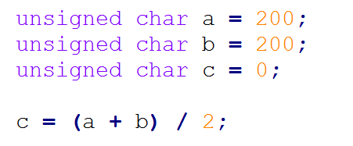
Controller data width
What is controller data width?
The controller data width reflects the maximum amount of data that processor can process and deliver at one time
Example: a 8 bit micro controller operates on 8 bits respectively at a time
Data overflow is an issue that should be consider. Check the following example:
9
RBEI/EEP1 | 9/23/2016
© Robert Bosch Engineering and Business Solutions Vietnam Company Limited 2016. All rights reserved, also regarding any disposal, exploitation, reproduction, editing, distribution, as well as in the event of applications for industrial property rights.

Slide 10
Controller data width
The expected result is c = 200. But it won't be. Why?
a + b is computed first giving 400 which is greater than 255 (8-bit limit). Hence the result will be an overflow and c will have incorrect data.
Solution : c = a / 2 + b / 2;
Or : c = (a >> 1) + (b >> 1);
10
RBEI/EEP1 | 9/23/2016
© Robert Bosch Engineering and Business Solutions Vietnam Company Limited 2016. All rights reserved, also regarding any disposal, exploitation, reproduction, editing, distribution, as well as in the event of applications for industrial property rights.

Slide 11
Controller data width
DGS have only 32bit controllers in use but theoretically it is possible to integrate AUTOSAR software modules also for 16bit or 8bit controller platforms
Upward portability must be possible (8bit −> 16bit −> 32bit)
Downward portability (32bit −> 16bit) is not requested
11
RBEI/EEP1 | 9/23/2016
© Robert Bosch Engineering and Business Solutions Vietnam Company Limited 2016. All rights reserved, also regarding any disposal, exploitation, reproduction, editing, distribution, as well as in the event of applications for industrial property rights.

Slide 12
Single Bit Handling
What is single bit?
Single bit is the smallest unit of data in a computer
A bit has a single binary value, either 0 or 1
In most computer systems, there are eight bits in a byte
bit
bit
0 | 1 | 1 | 0 | 1 | 0 | 0 | 1
byte
12
RBEI/EEP1 | 9/23/2016
© Robert Bosch Engineering and Business Solutions Vietnam Company Limited 2016. All rights reserved, also regarding any disposal, exploitation, reproduction, editing, distribution, as well as in the event of applications for industrial property rights.

Slide 13
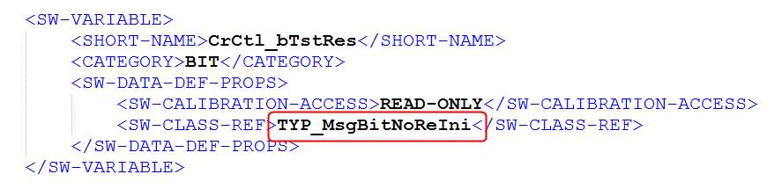
Single Bit Handling
The data type _bit is not portable and shall therefore not used in the C−code.
The only possible way to use single bits in MEDC17:
The base types bool, boolean and bit shall be considered of BIT category
Only Manual Code and ASCET (not Mathlab/Simulink): Variables and messages of BIT category should be specified in PaVaSt by using DAMOS−models (TYP_MsgBitNoReIni, TYP_SingleBit*).
13
RBEI/EEP1 | 9/23/2016
© Robert Bosch Engineering and Business Solutions Vietnam Company Limited 2016. All rights reserved, also regarding any disposal, exploitation, reproduction, editing, distribution, as well as in the event of applications for industrial property rights.

Slide 14
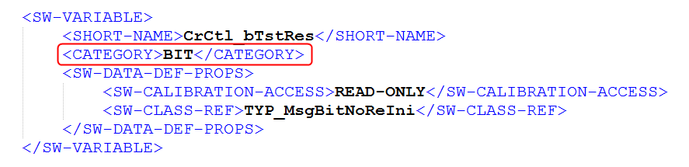
Single Bit Handling
The CATEGORY VALUE shall not be used together with bit, bool and boolean type.
14
RBEI/EEP1 | 9/23/2016
© Robert Bosch Engineering and Business Solutions Vietnam Company Limited 2016. All rights reserved, also regarding any disposal, exploitation, reproduction, editing, distribution, as well as in the event of applications for industrial property rights.

Slide 15
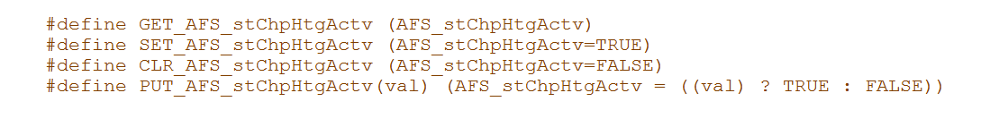
Single Bit Handling
In C−Code the variables and messages of BIT category and bit type shall be accessed only via the tool chain generated macros GET_, SET_, PUT_, CLR_ .
15
RBEI/EEP1 | 9/23/2016
© Robert Bosch Engineering and Business Solutions Vietnam Company Limited 2016. All rights reserved, also regarding any disposal, exploitation, reproduction, editing, distribution, as well as in the event of applications for industrial property rights.

Slide 16
Assembler programming
EXAMPLE
#define Cpu_ResumeInt()
/* enable interrupt system only, if it was enabled prior to calling Cpu_SuspendInt() */
asm volatile ("jz.t %0,8,0f; enable; 0:"::"d" (stPreviousStateOfCpuIntSystem_u32):"memory");
/* IGNORE RULE 3411: To balance Cpu_SuspendInt and Cpu_ResumeInt unbalanced brackets are used */
} do { } while(0) /* this ugly statement is necessary to cheat MISRA checker */
#else
16
RBEI/EEP1 | 9/23/2016
© Robert Bosch Engineering and Business Solutions Vietnam Company Limited 2016. All rights reserved, also regarding any disposal, exploitation, reproduction, editing, distribution, as well as in the event of applications for industrial property rights.

Slide 17
Assembler programming
Pros
Software will be executed faster
Cons
Depend on each μC and each compiler.
Only useful in special cases like service library, complex drivers.
The portability will be lost.
17
RBEI/EEP1 | 9/23/2016
© Robert Bosch Engineering and Business Solutions Vietnam Company Limited 2016. All rights reserved, also regarding any disposal, exploitation, reproduction, editing, distribution, as well as in the event of applications for industrial property rights.

Slide 18
Intrinsic functions
An intrinsic function (or builtin function) is a function (subroutine) available for use in a given programming language which implementation is handled specially by the compiler.
Intrinsic instructions are not portable between different compilers and μC platforms.
Do not use intrinsic instructions in AUTOSAR software modules.
18
RBEI/EEP1 | 9/23/2016
© Robert Bosch Engineering and Business Solutions Vietnam Company Limited 2016. All rights reserved, also regarding any disposal, exploitation, reproduction, editing, distribution, as well as in the event of applications for industrial property rights.

Slide 19
Thank you

